Slide 1

DS5220 Project Final Presentation
Market Analysis of
S&P
500 Index
Sai Nikhil Kunapareddy and Dilep Shetty Ittanguru Venkatesh

Slide 2

DS5220 Project Final Presentation
Market Analysis of
S&P
500 Index
Sai Nikhil Kunapareddy and Dilep Shetty Ittanguru Venkatesh

Slide 3
S&P
Standard and Poor’s 500
US Market’s Benchmark
Sector Representation
Objective(s)

Slide 4

Market Analysis of
S&P 500 Index
Sai Nikhil Kunapareddy and Dilep Shetty Ittanguru Venkatesh
Objective(s)
Deep Dive Into
Time-Series Forecasting
Comparative Study of Statistical and Deep Learning Models
Understand the Limitations of Time-Series Forecasting

Slide 5
Time-Series Forecasting
Temporal Order
Trend
Seasonality
Cyclicity
Index Performance Since 1994

Slide 6

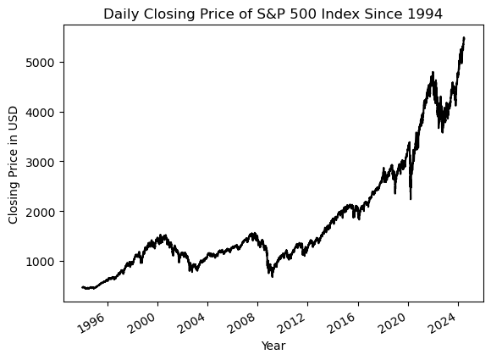
Objective(s)
Index Performance Since 1994
Density Plot

Slide 7
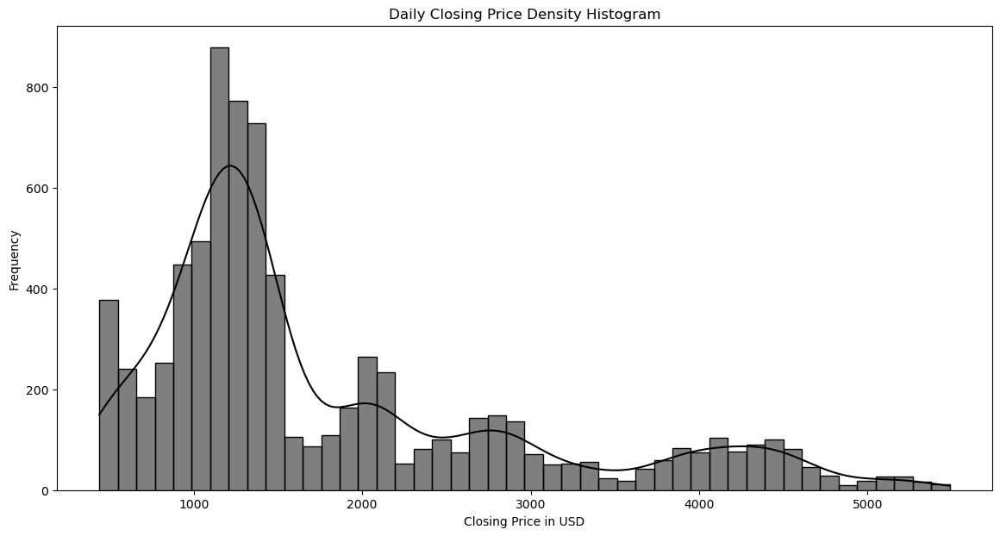
Index Performance Since 1994
Prediction Models
Density Plot
ARIMA
SARIMA
LSTM
PROPHET

Slide 8
Density Plot
Prediction Models
AutoRegressive
ARIMA
SARIMA
Integrated
Moving Average
LSTM
PROPHET

Slide 9
Prediction Models
ARIMA
Regression with
prior values
AutoRegressive
Integrated
Differencing observations for stationarity
Moving Average
Dependency with
prior residuals
SARIMA
LSTM
PROPHET

Slide 10
Prediction Models
ARIMA
AutoRegressive
Regression with
prior values
Differencing observations for stationarity
Integrated
Moving Average
Dependency with
prior residuals
SARIMA
LSTM
PROPHET

Slide 11
ARIMA
SARIMA
Seasonal
AutoRegressive
Differencing
Integrated
Autoregression
Moving Average
Moving average
Period
LSTM
PROPHET

Slide 12
ARIMA
SARIMA
AutoRegressive
Differencing
Seasonal
Integrated
Autoregression
Moving Average
Moving average
Period
LSTM
PROPHET

Slide 13
SARIMA
LSTM
Long
Forget
Short-Term
Memory
Input
Output
PROPHET
Open Source
Meta’s Data Science Team

Slide 14
LSTM
Forget
Memory
Input
Output
PROPHET
Open Source
Meta’s Data Science Team

Slide 15

LSTM
PROPHET
Statistical Method
Fourier Series for Seasonality
Hyperparameter Tuning
Model Predictions

Slide 16
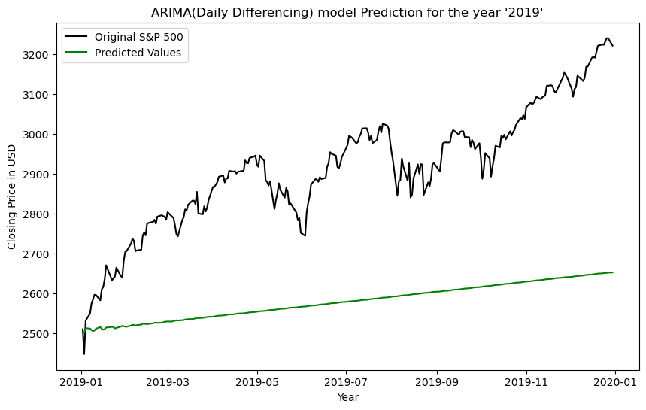
PROPHET
ARIMA
Model Predictions
Train Period
2010 - 2018
Test Period
2019

Slide 17
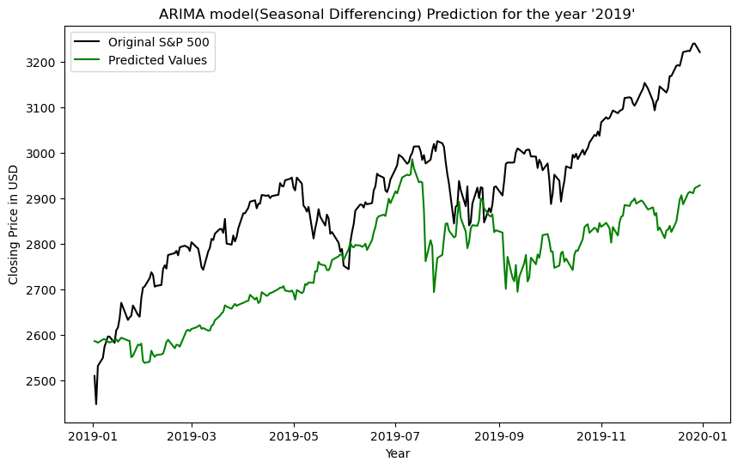
Model Predictions
ARIMA

Slide 18
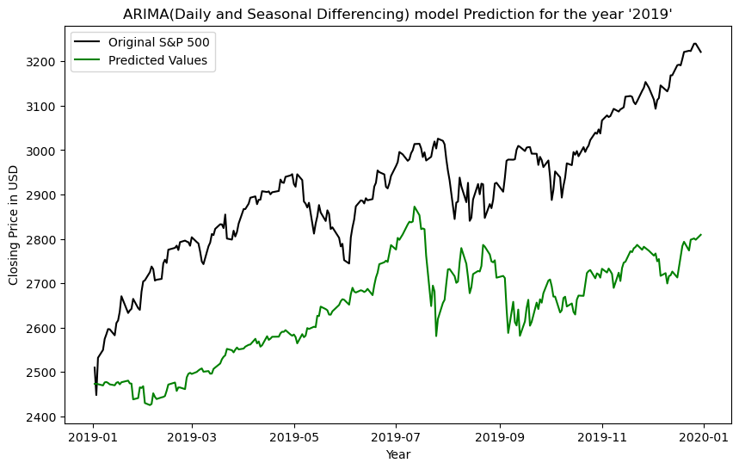
Model Predictions
ARIMA
Model
Evaluation

Slide 19
SARIMA
Model Predictions
ARIMA

Slide 20
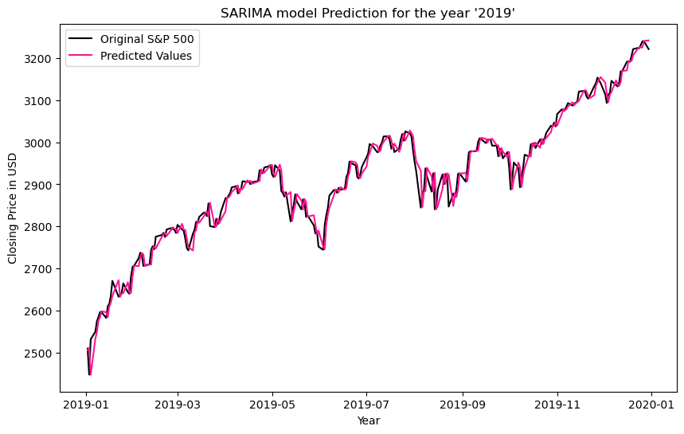
LSTM
Model Predictions
SARIMA

Slide 21
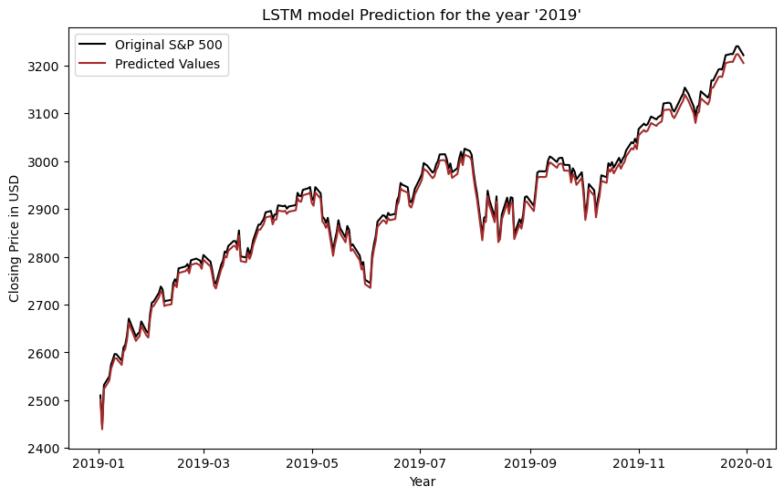
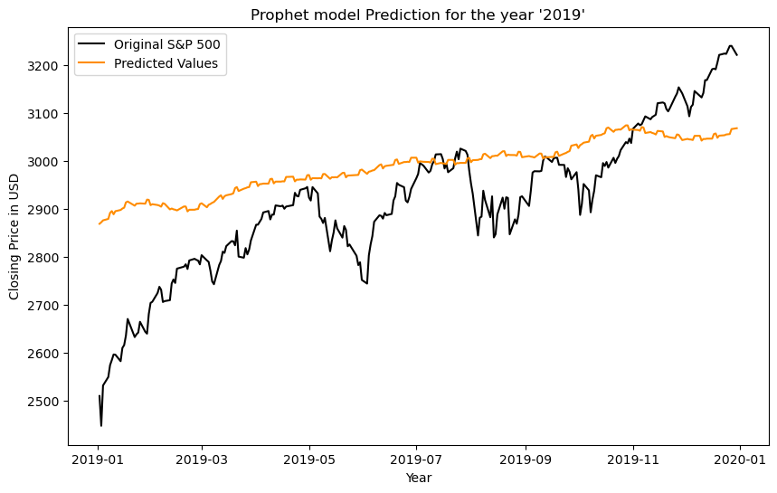
PROPHET
Model Predictions
LSTM

Slide 22
Model Predictions
PROPHET
Conclusion

Slide 23
PROPHET
Conclusion
LSTM
Can Capture Non-Linearity
SARIMA
Right P, D and Q Values
PROPHET
Lack of Hyperparameter Tuning
ARIMA
Inherent Model Limitation
Thank you!

Slide 24
Thank you!

Slide 25
APPENDIX

Slide 26
Model Evaluation
123350
Mean Absolute Error
ARIMA
Daily Differencing
351
Root Mean Square Error
33409
Mean Absolute Error
ARIMA
Seasonal Differencing
182
Root Mean Square Error
82643
Mean Absolute Error
ARIMA
Daily and Seasonal Differencing
287
Root Mean Square Error

Slide 27
Model Evaluation
505
Mean Absolute Error
SARIMA
22
Root Mean Square Error
122
Mean Absolute Error
LSTM
11
Root Mean Square Error
16749
Mean Absolute Error
PROPHET
129
Root Mean Square Error

Slide 28
References
[1] Pham Hoang Vuong, Lam Hung Phu, T. Hong, Le Nhat Duy, Pham The Bao, and Tan Dat Trinh, “A bibliometric literature review of stock price forecasting: From statistical model to deep learning approach,” Science progress, vol. 107, no. 1, Jan. 2024, doi: https://doi.org/10.1177/00368504241236557.
[2] Modelling logic was adapted from https://www.kaggle.com/kushal1506.

